Slide 1
Process and Product Metrics

Slide 2
Measures and Metrics
A measure provides a quantitative indication of the extent, amount, dimension, capacity, or size of some attribute of a product or process
The IEEE glossary defines a metric as “a quantitative measure of the degree to which a system, component, or process possesses a given attribute.”
These slides are designed to accompany Software Engineering: A Practitioner’s Approach, 7/e (McGraw-Hill 2009). Slides copyright 2009 by Roger Pressman.

Slide 3
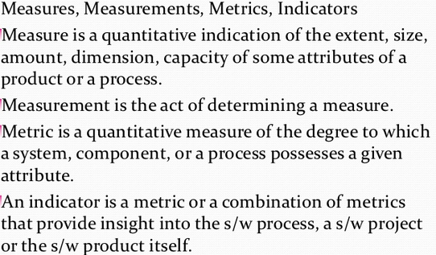

Slide 4
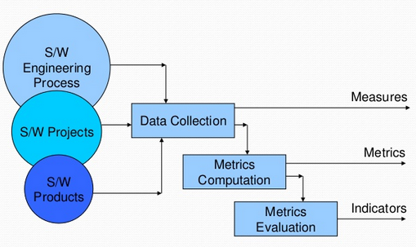
Software Metrics

Slide 5
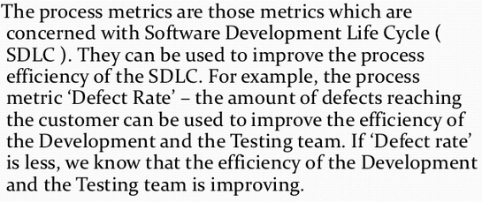
Process Metrics

Slide 6
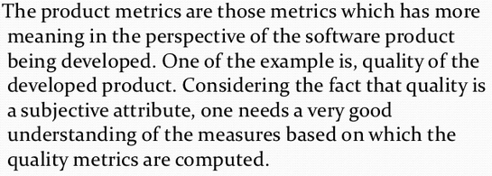
Product Metrics

Slide 7
Measurement Principles
The objectives of measurement should be established before data collection begins;
Each technical metric should be defined in an unambiguous manner;
Metrics should be derived based on a theory that is valid for the domain of application
Metrics should be tailored to best accommodate specific products and processes [Bas84]
These slides are designed to accompany Software Engineering: A Practitioner’s Approach, 7/e (McGraw-Hill 2009). Slides copyright 2009 by Roger Pressman.

Slide 8
Measurement Process
Formulation. The derivation of software measures and metrics appropriate for the representation of the software that is being considered.
Collection. The mechanism used to accumulate data required to derive the formulated metrics.
Analysis. The computation of metrics and the application of mathematical tools.
Interpretation. The evaluation of metrics results in an effort to gain insight into the quality of the representation.
Feedback. Recommendations derived from the interpretation of product metrics transmitted to the software team.

Slide 9
Metrics Attributes
Simple and computable. It should be relatively easy to learn how to derive the metric, and its computation should not demand inordinate effort or time
Empirically and intuitively persuasive. The metric should satisfy the engineer’s intuitive notions about the product attribute under consideration
Consistent and objective. The metric should always yield results that are unambiguous.
Consistent in its use of units and dimensions. The mathematical computation of the metric should use measures that do not lead to unusual combinations of unit.
Programming language independent. Metrics should be based on the analysis model, the design model, or the structure of the program itself.
Effective mechanism for quality feedback. That is, the metric should provide a software engineer with information that can lead to a higher quality end product
These slides are designed to accompany Software Engineering: A Practitioner’s Approach, 7/e (McGraw-Hill 2009). Slides copyright 2009 by Roger Pressman.

Slide 10
Metrics for the Requirements Model
Function-based metrics: use the function point as a normalizing factor or as a measure of the “size” of the specification.
Specification metrics: used as an indication of quality by measuring number of requirements by type.
These slides are designed to accompany Software Engineering: A Practitioner’s Approach, 7/e (McGraw-Hill 2009). Slides copyright 2009 by Roger Pressman.

Slide 11
Function-Based Metrics
The function point metric (FP), first proposed by Albrecht [ALB79], can be used effectively as a means for measuring the functionality delivered by a system.
The function point (FP) metric can be used effectively as a means for measuring the functionality delivered by a system.
Information domain values are defined in the following manner:
  number of external inputs (EIs)
  number of external outputs (EOs)
  number of external inquiries (EQs)
  number of internal logical files (ILFs)
  Number of external interface files (EIFs)
These slides are designed to accompany Software Engineering: A Practitioner’s Approach, 7/e (McGraw-Hill 2009). Slides copyright 2009 by Roger Pressman.

Slide 12
Function points are derived using an empirical relationship based on countable (direct) measures of software’s information domain and qualitative assessments of software complexity.
Using historical data, the FP metric can then be used to
(1) estimate the cost or effort required to design, code, and test the software;
(2) predict the number of errors that will be encountered during testing; and
(3) Forecast the number of components and/or the number of projected source lines in the
implemented system.
These slides are designed to accompany Software Engineering: A Practitioner’s Approach, 7/e (McGraw-Hill 2009). Slides copyright 2009 by Roger Pressman.

Slide 13
Value adjustment factors (VAF) based on responses to the following questions
1. Does the system require reliable backup and recovery?
2. Are specialized data communications required to transfer information to or from the application?
3. Are there distributed processing functions?
4. Is performance critical?
5. Will the system run in an existing, heavily utilized operational environment?
6. Does the system require online data entry?
These slides are designed to accompany Software Engineering: A Practitioner’s Approach, 7/e (McGraw-Hill 2009). Slides copyright 2009 by Roger Pressman.

Slide 14
7. Does the online data entry require the input transaction to be built over multiple
screens or operations?
8. Are the ILFs updated online?
9. Are the inputs, outputs, files, or inquiries complex?
10. Is the internal processing complex?
11. Is the code designed to be reusable?
12. Are conversion and installation included in the design?
13. Is the system designed for multiple installations in different organizations?
14. Is the application designed to facilitate change and ease of use by the user?
These slides are designed to accompany Software Engineering: A Practitioner’s Approach, 7/e (McGraw-Hill 2009). Slides copyright 2009 by Roger Pressman.

Slide 15
Fan-in is a measure of the number of functions or methods that call another function or method (say X).
Fan-out is the number of functions that are called by function X.
A high value for fan-in means that X is tightly coupled to the rest of the design and changes to X will have extensive knock-on effects.
A high value for fan-out suggests that the overall complexity of X may be high because of the complexity of the control logic needed to coordinate the called components.
These slides are designed to accompany Software Engineering: A Practitioner’s Approach, 7/e (McGraw-Hill 2009). Slides copyright 2009 by Roger Pressman.

Slide 16
Architectural Design Metrics
METRICS FOR THE DESIGN MODEL
Architectural design metrics focus on characteristics of the program architecture with an emphasis on the architectural structure and the effectiveness of modules or components within the architecture.
Three software design complexity measures:
structural complexity, data complexity, and system complexity.
These slides are designed to accompany Software Engineering: A Practitioner’s Approach, 7/e (McGraw-Hill 2009). Slides copyright 2009 by Roger Pressman.

Slide 17

Fan-in: the number of modules that call a given module.(Super module)
Fan-out: the numbers of modules that called by a given module(Sub – Modules) or the number of modules that are directly invoked by super module.
For hierarchical architectures (e.g., call-and-return
architectures), structural complexity of a module i is defined
in the following manner:
where fout(i) is the fan-out of module i.
These slides are designed to accompany Software Engineering: A Practitioner’s Approach, 7/e (McGraw-Hill 2009). Slides copyright 2009 by Roger Pressman.

Slide 18

Data complexity provides an indication of the complexity in the internal interface for a module i and is defined as
where v(i) is the number of input and output variables that are passed to and from module i.
System complexity is defined as the sum of structural and data complexity, specified as
As each of these complexity values increases, the overall architectural complexity of the system also increases.

Slide 19
Metrics for OO Design-I
Whitmire [Whi97] describes nine distinct and measurable characteristics of an OO design:
Size
  Size is defined in terms of four views: population, volume, length, and functionality
Complexity
  How classes of an OO design are interrelated to one another
Coupling
  The physical connections between elements of the OO design
Sufficiency
  “the degree to which an abstraction possesses the features required of it, or the degree to which a design component possesses features in its abstraction, from the point of view of the current application.”
Completeness
An indirect implication about the degree to which the abstraction or design component can be reused

Slide 20
Metrics for OO Design-II
  Cohesion
    The degree to which all operations working together to achieve a single, well-defined purpose
  Primitiveness
    Applied to both operations and classes, the degree to which an operation is atomic
  Similarity
    The degree to which two or more classes are similar in terms of their structure, function, behavior, or purpose
  Volatility
    Measures the likelihood that a change will occur
These slides are designed to accompany Software Engineering: A Practitioner’s Approach, 7/e (McGraw-Hill 2009). Slides copyright 2009 by Roger Pressman.

Slide 21
Why Do We Measure?
Software Measurement
assess the status of an ongoing project
track potential risks
uncover problem areas before they go “critical,”
adjust work flow or tasks,
evaluate the project team’s ability to control quality of software work products.
These slides are designed to accompany Software Engineering: A Practitioner’s Approach, 7/e (McGraw-Hill 2009). Slides copyright 2009 by Roger Pressman.

Slide 22
Process Measurement
We measure the efficiency of a software process indirectly.
  That is, we derive a set of metrics based on the outcomes that can be derived from the process.
  Outcomes include
    measures of errors uncovered before release of the software
    defects delivered to and reported by end-users
    work products delivered (productivity)
    human effort expended
    calendar time expended
    schedule conformance
    other measures.
These slides are designed to accompany Software Engineering: A Practitioner’s Approach, 7/e (McGraw-Hill 2009). Slides copyright 2009 by Roger Pressman.

Slide 23
Software Process Improvement
Process model
SPI
Process improvement
recommendations
Improvement goals
Process metrics
These slides are designed to accompany Software Engineering: A Practitioner’s Approach, 7/e (McGraw-Hill 2009). Slides copyright 2009 by Roger Pressman.

Slide 24
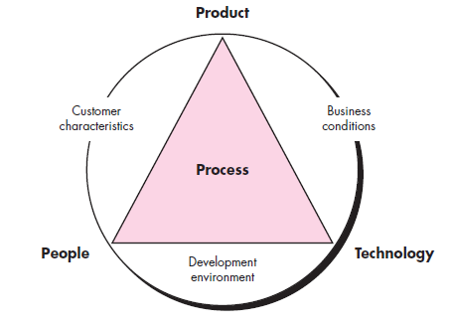
Determinants for software quality and organizational effectiveness
These slides are designed to accompany Software Engineering: A Practitioner’s Approach, 7/e (McGraw-Hill 2009). Slides copyright 2009 by Roger Pressman.

Slide 25
Direct measures of the software process include cost and effort applied.
Direct measures of the product include lines of code (LOC) produced, execution speed, memory size, and defects reported over some set period of time
Indirect measures of the product include functionality, quality, complexity, efficiency, reliability, maintainability, and many other “–abilities”
These slides are designed to accompany Software Engineering: A Practitioner’s Approach, 7/e (McGraw-Hill 2009). Slides copyright 2009 by Roger Pressman.

Slide 26
Size-Oriented Metrics
Size-oriented software metrics are derived by normalizing quality and/or productivity measures by considering the size
of the software that has been produced.
Errors per KLOC (thousand lines of code)
• Defects per KLOC
• $ per KLOC
• Pages of documentation per KLOC
In addition, other interesting metrics can be computed:
• Errors per person-month
• KLOC per person-month
• $ per page of documentation
These slides are designed to accompany Software Engineering: A Practitioner’s Approach, 7/e (McGraw-Hill 2009). Slides copyright 2009 by Roger Pressman.

Slide 27
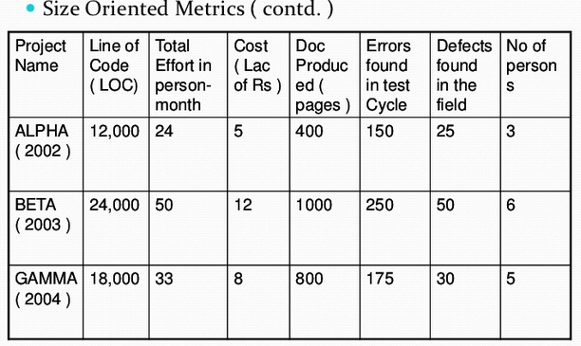
These slides are designed to accompany Software Engineering: A Practitioner’s Approach, 7/e (McGraw-Hill 2009). Slides copyright 2009 by Roger Pressman.

Slide 28
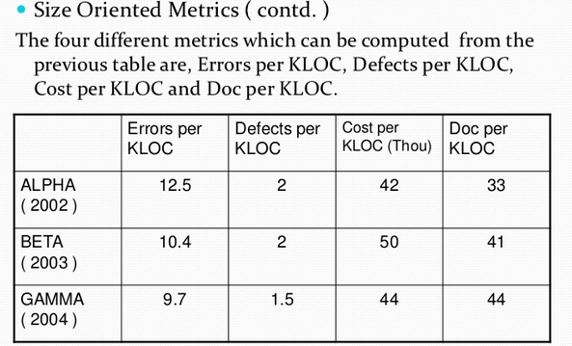
These slides are designed to accompany Software Engineering: A Practitioner’s Approach, 7/e (McGraw-Hill 2009). Slides copyright 2009 by Roger Pressman.

Slide 29
Function-Oriented Metrics
Function-oriented software metrics use a measure of the functionality delivered by the application as a normalization value.
Computation of the function point is based on characteristics of the software’s information domain and complexity
These slides are designed to accompany Software Engineering: A Practitioner’s Approach, 7/e (McGraw-Hill 2009). Slides copyright 2009 by Roger Pressman.

Slide 30
Measuring Quality
Metrics for Software Quality
Correctness — the degree to which a program operates according to specification
Maintainability—the degree to which a program is amenable to change
Integrity—the degree to which a program is impervious to outside attack
Usability—the degree to which a program is easy to use
These slides are designed to accompany Software Engineering: A Practitioner’s Approach, 7/e (McGraw-Hill 2009). Slides copyright 2009 by Roger Pressman.

Slide 31
Defect Removal Efficiency
DRE = E /(E + D)
where:
E is the number of errors found before delivery of the software to the end-user
D is the number of defects found after delivery.
These slides are designed to accompany Software Engineering: A Practitioner’s Approach, 7/e (McGraw-Hill 2009). Slides copyright 2009 by Roger Pressman.

